Slide 1
Playing Card Detection & Identification

Slide 2
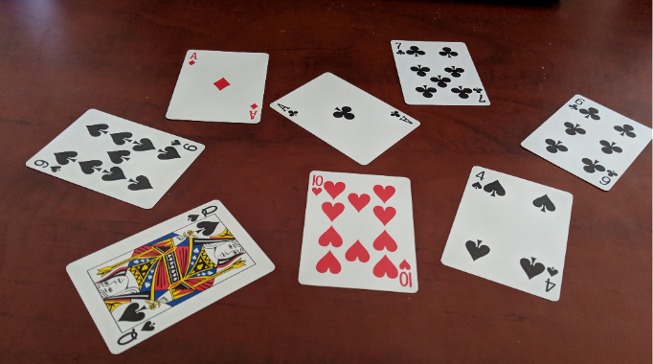
Project Goals
Detecting boundary of playing cards in an image
Identify suit of each card
Identify value of each card
Find the success rate thanks to F-score

Slide 3
Playing Card Detection
Contrast enhancement
i apply histogram equalization to make each card more visible.
imadjust ()

Slide 4
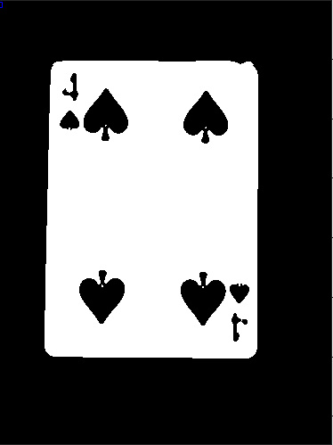
Playing Card Detection
Binary Image Thresholding
Binary thresholding was performed using Otsu’s method.
0 for values which are below the certain value (black)
1 for values which above the certain value (white)

Slide 5
Playing Card Detection
Noise Removing
Apply Gaussian filter and median filter to remove noises in the background.
bwlabel(): i labelled the number of cards

Slide 6
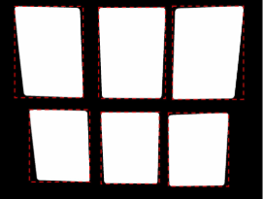
Playing Card Detection
Regionprops
Use bounding box property of regionprops to find each card in the image
Generate subimage for each card and have

Slide 7

Playing Card Detection
Canny Edge Detection
Find the edges of each subimage which is
located in boundary boxes.
Threshold : 0.5

Slide 8
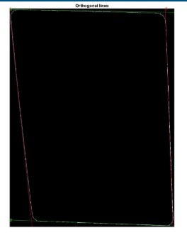
Playing Card Detection
Line Detection
Use hought transform to find lines in subimages
(i.e edges of cards).
houghlines()
houghkpeaks()

Slide 9
Playing Card Detection
Rotation
Find the rotating angle thanks to property of regionprop
Rotate each card according to angle
Crop each card from their edges

